Slide 1
Photon Breast Tissue Expanders Contouring and HU Overrides
Emily Hubley
Work by Erika Bilokon

Slide 2
Common Expanders

Slide 3
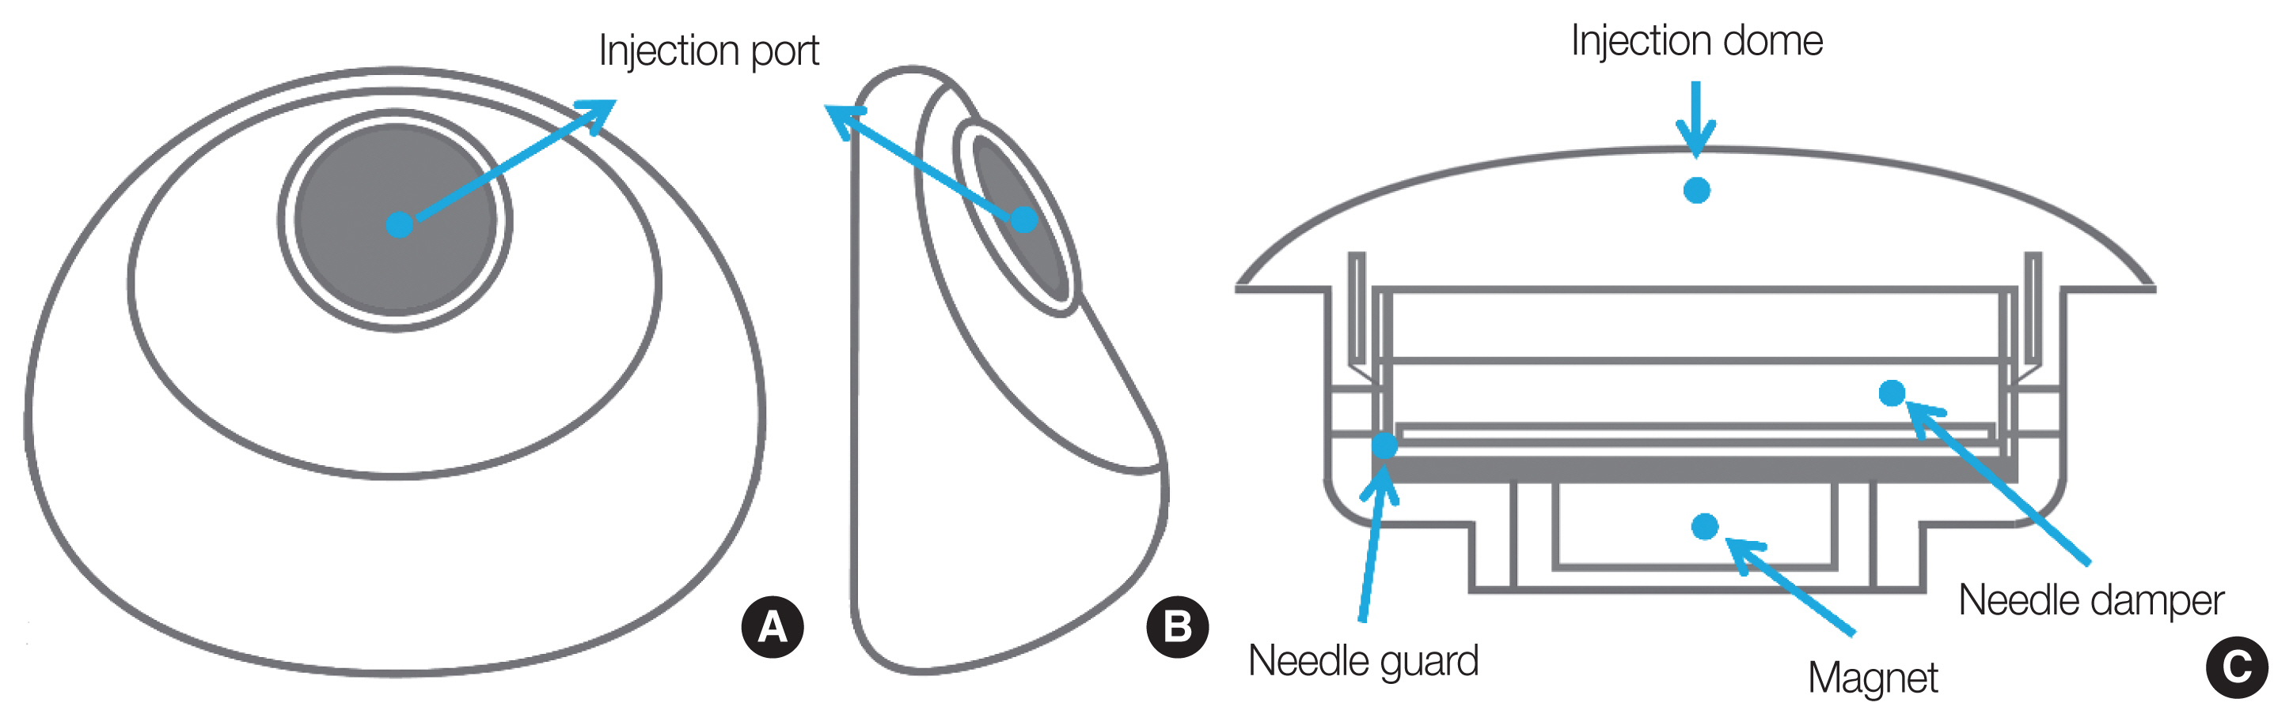
In General
Expander is filled with saline
There is an injection port which consists of two parts:
Very high Z magnet – this allows the surgeon to locate the injection port to inject saline
Magnet is surrounded by a thin cup-shaped titanium/stainless steel needle guard to prevent accidental rupture when filling

Slide 4
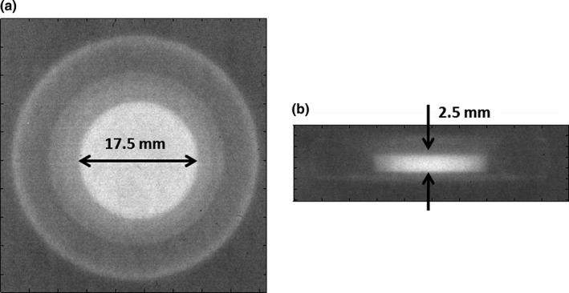
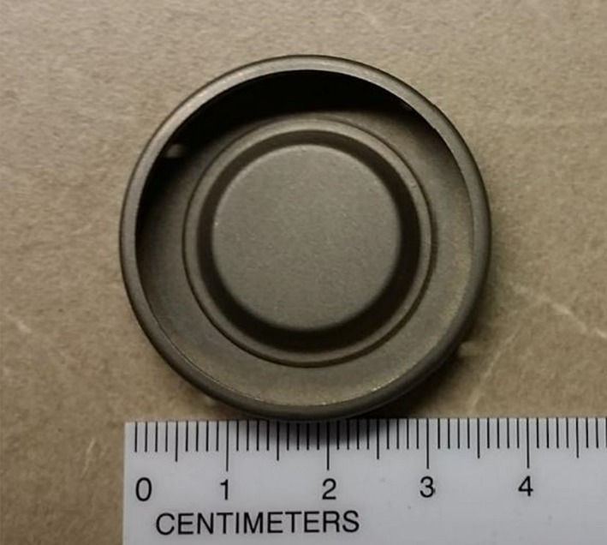
Allergan Natrelle 133s
https://pmc.ncbi.nlm.nih.gov/articles/PMC5978546/

Slide 5
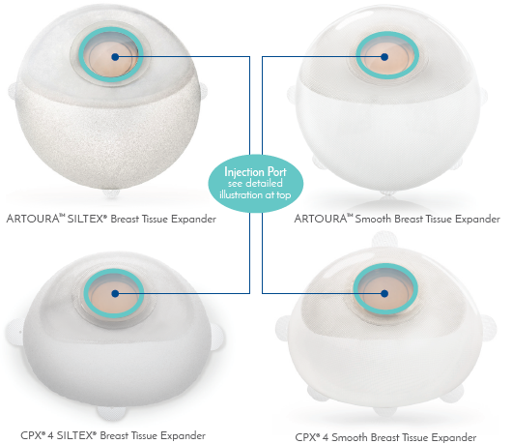
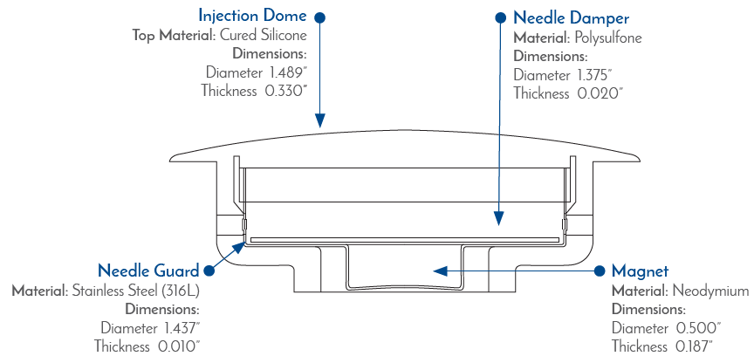
Mentor CPX4 and Artoura
Artoura and CPX4 Smooth and SILTEX expanders all use the same port
I got this info from Mentor Medical Affairs August 2024

Slide 6
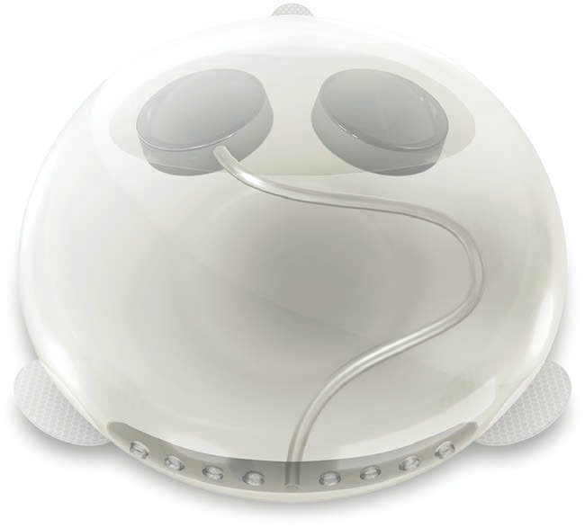
Sientra Allo X2
Easier to identify because they have two ports/magnets
One port for filling
One port is connected to a drain inferiorly and can be used to drain fluid from the surgical cavity

Slide 7
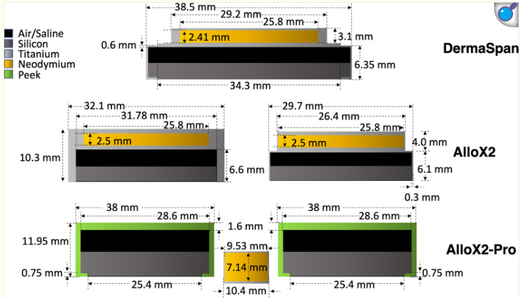
Sientra Allo X2
https://pmc.ncbi.nlm.nih.gov/articles/PMC10151677/

Slide 8
Contouring and Overrides

Slide 9
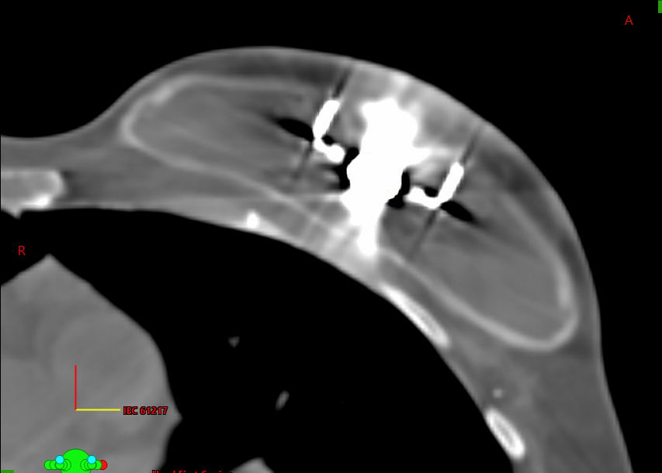

Slide 10
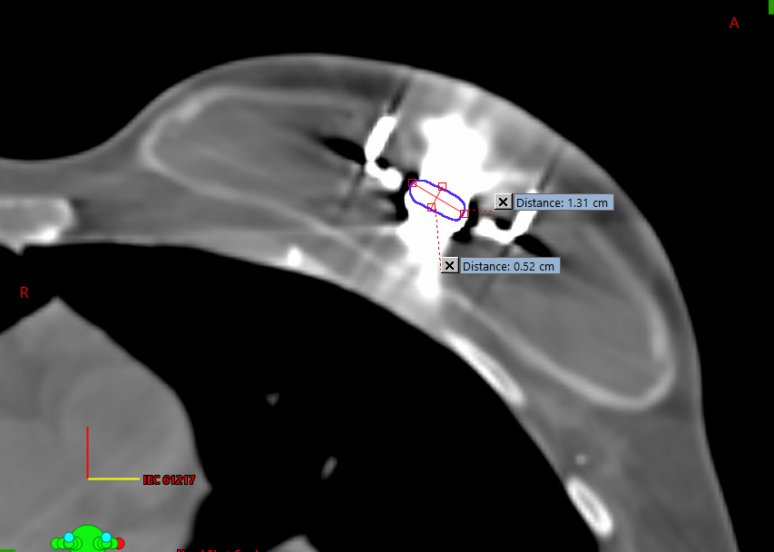
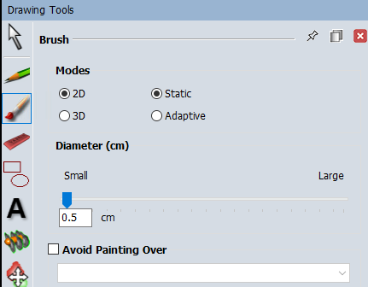
Contour the Magnet
Dimensions should roughly match the actual magnet dimensions - table
Override the HU – per table
The saturated volume will be much larger than the actual magnet. Contour just the magnet and not the entire saturated volume.

Slide 11
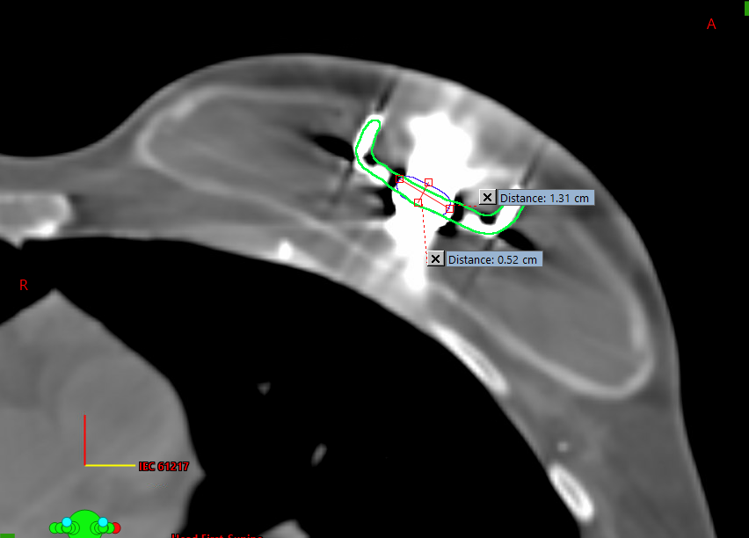
Contour the Needle Guard
Use a narrow brush
Do not override HU (the needle guard is too thin to accurately contour)

Slide 12
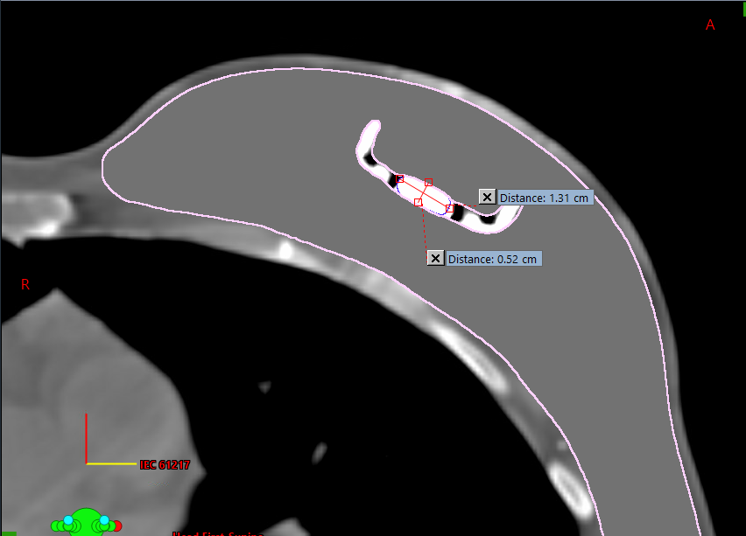
Contour the Saline
Contour any artifacts (most importantly the very high HU artifact in front of and behind the magnet)
Use Boolean tool to remove the magnet and needle guard contours
Override to water (0 HU)

Slide 13
Magnet/Needle Guard Dimensions and Densities
Expander | # of ports | Magnet Dimension | Magnet Material | Needle guard Dimension | Needle guard Material
Mentor CPX4 and Artoura | 1 | Diameter = 12.7 mm Thickness =4.8 mm | Neodymium 7.6 g/cm3 | Diameter = 36.5 mm Thickness = 0.5 mm | Stainless Steel
Allergan Natrelle 133s (type II) | 1 | Diameter = 17.6 mm Thickness = 2.5 mm | Samarium cobalt 7.5 g/cm3 | Diameter = 36 mm Thickness = 0.6 mm | Titanium
Sientra AlloX2 | 2 | Diameter = 25.8 mm Thickness = 2.5 mm | Neodymium 7.6 g/cm3 | Diameter = 32.1 or 29.7 mm Thickness = 3 mm or 0.3mm | Titanium

Slide 14
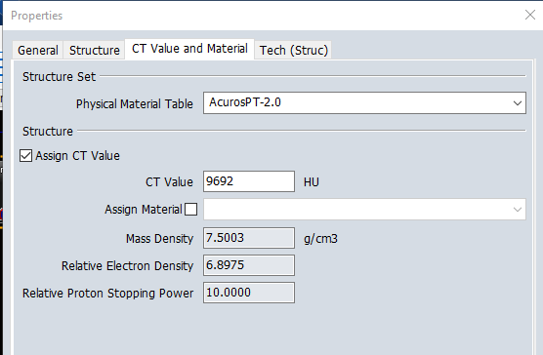
Which HU?
In the contouring workspace, right click on the magnet contour
Properties
“CT Value and Material” Tab
Check the “Assign CT Value” box
We want a mass density of 7.5 or 7.6g/cm³
The exact HU will depend on the CT scanner
Start by typing in 9600 HU and adjust until you get close to the desired mass density
Does not have to be exact
If the CT curve doesn’t go high enough, just put in the highest HU you can

Slide 15
Example patient - AAA
Kelly, Jaime 012620860
Structure set: EVAL override 5
Structures:
(D) magnet
(D) guard
(D) saline

Slide 16
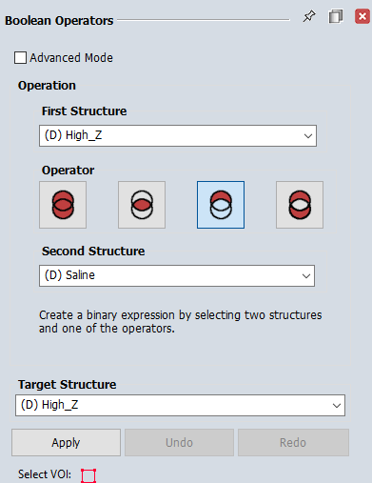
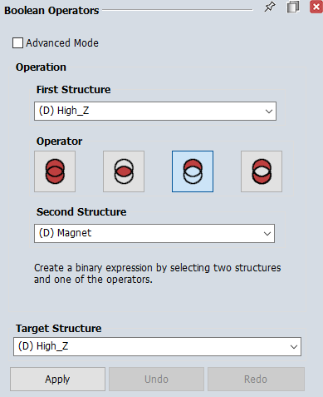
For Acuros AXB:
Follow the steps above to create:
(D) Saline
(D) Magnet
(D) Needle guard
Then contour the (D) high Z as normal for Acuros plans
From the (D) high Z, subtract the magnet and the saline
This will result in any high Z voxels in the needle guard to be included in the (D) high Z structure

Slide 17
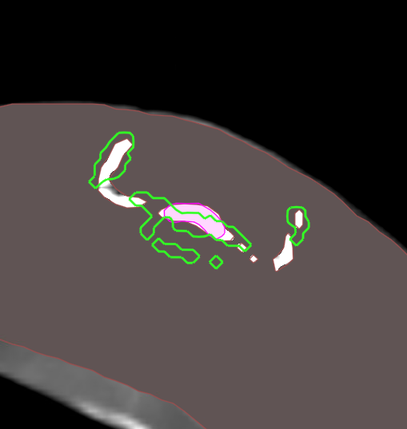
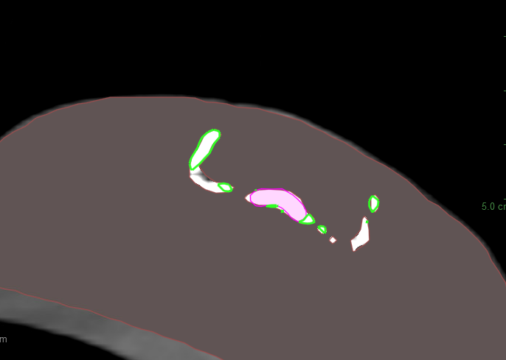
Contour the (D) high Z
Subtract out the magnet and saline

Slide 18
Example patient – Acuros AXB
Peopples, Sheila 04258174
Structure set: CT_071625DIBH
Structures:
(D) magnet
(D) guard
(D) saline
(D) high Z

Slide 19
Finding out which expander?

Slide 20
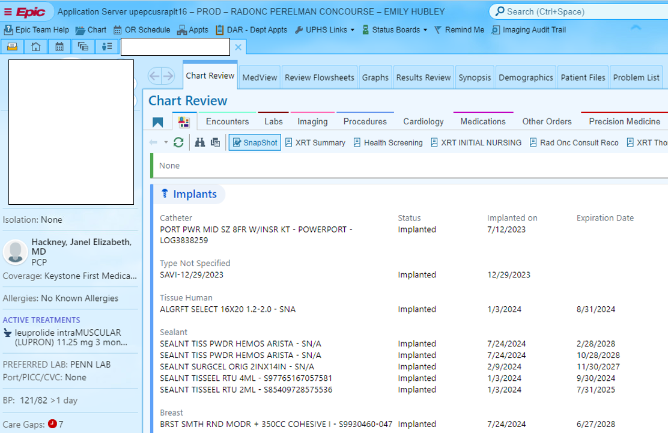
c
Open the patient’s chart in EPIC:
Option 1:
Click this tab here:
Scroll down to “Implants” section.
Sometimes it will be listed here.
Option 2:
In the search bar at the top, search for any of the Expander models or brands: “mentor” “CPX4” “Artoura” “allergan” “Natrelle” or “Sientra” “Allo X2”
Sometimes it will find the expanders in the surgeons Op note

Slide 21
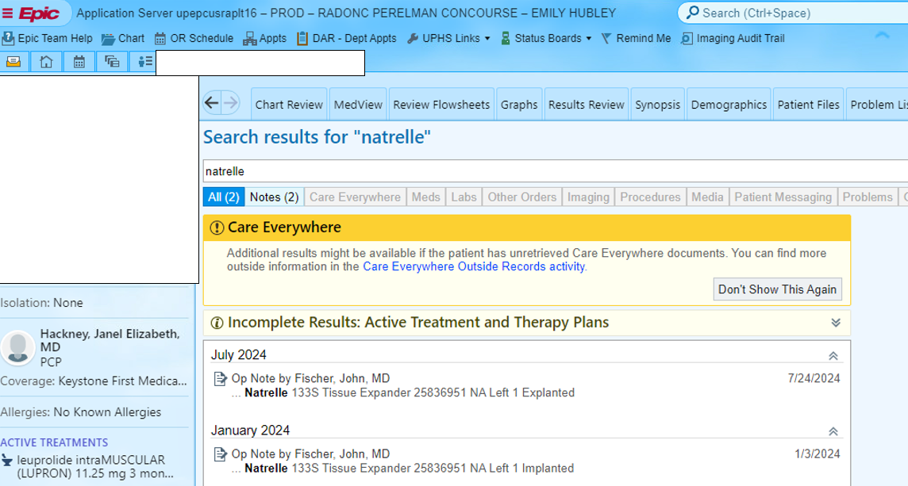
c

